Slide 1


Overview of Heritage Health Enrollment Process
Automated Health systems

Slide 2

Member Participation
Mandatory – Required to Participate
•Members who do not choose will be auto assigned
•90 days to try out the health plan
Excluded – Not able to Participate
•May not enroll at this time

Slide 3




Health Plan Advantages
Freedom of Choice
Members select the health plan that best fits their needs
Empowerment
By taking an active role in their health care and choosing a health plan
Access to Health Care
Access to services not covered by Medicaid in the form of value-added services
Choice Counselors
Ready to assist members by phone
Online Information
Access to information and enrollment through our website www.neheritagehealth.com

Slide 4
Choice Counseling
Heritage Health Choice Counseling is a free service made available to our members. There are never any costs associated with Choice Counseling services.
The goal is to help everyone make an informed decision and select the health plan that meets their needs and will lead to better health outcomes.
Choice Counselors can provide information on:
Heritage Health
Value-Added Services
Website Tools
Enrollment Timelines
Health Plan Choices

Slide 5
Choice Counseling
Outreach and Education
Outbound and Inbound Calls
Group Presentations to Stakeholders
Partnership Development and Referrals
Group Presentations to Providers and Staff

Slide 6
Enrollment Process
Choice Counselors not only provide information, they are involved in completing the enrollment and managing the entire selection process. Choice Counselors also assist members with their right to change health plans in their initial 90 days of coverage
Eligibility: determined by the Department of Health and Human Services (DHHS)
Initial Enrollment and Plan Changes: completed by Choice Counselors
Action | Responsible Party
Eligibility | DHHS
Initial Enrollment | Choice Counselors
Plan Changes | Choice Counselors

Slide 7
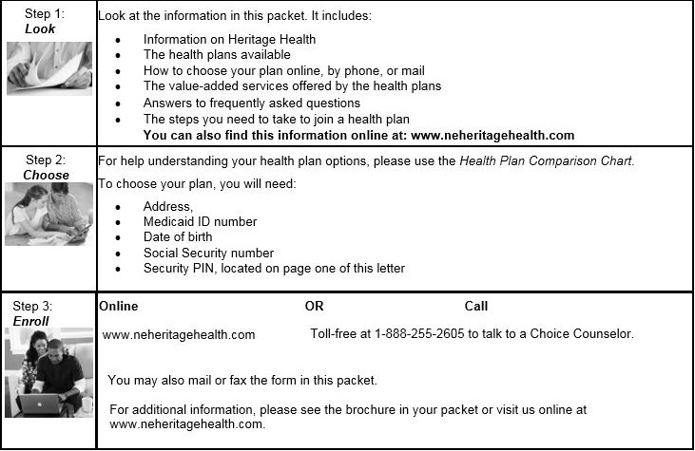



Enrollment Process
Medicaid members who take advantage of choice counseling to help them select their health plan not only secure their choice, they also are empowered with the knowledge necessary to get the best care available to them.

Slide 8
Enrollment Avenues
Phone: 1-888-255-2605
Online: www.neheritagehealth.com
Mail: Complete the enrollment form and return it in the postage-paid envelope provided

Slide 9
Enrollment Broker Goals
Our Goals:
Reach, understand, and accommodate individuals with special needs
Enhance the choice counseling component and availability
Give focused and unbiased information to the members

Slide 10

www.neheritagehealth.com

Slide 11
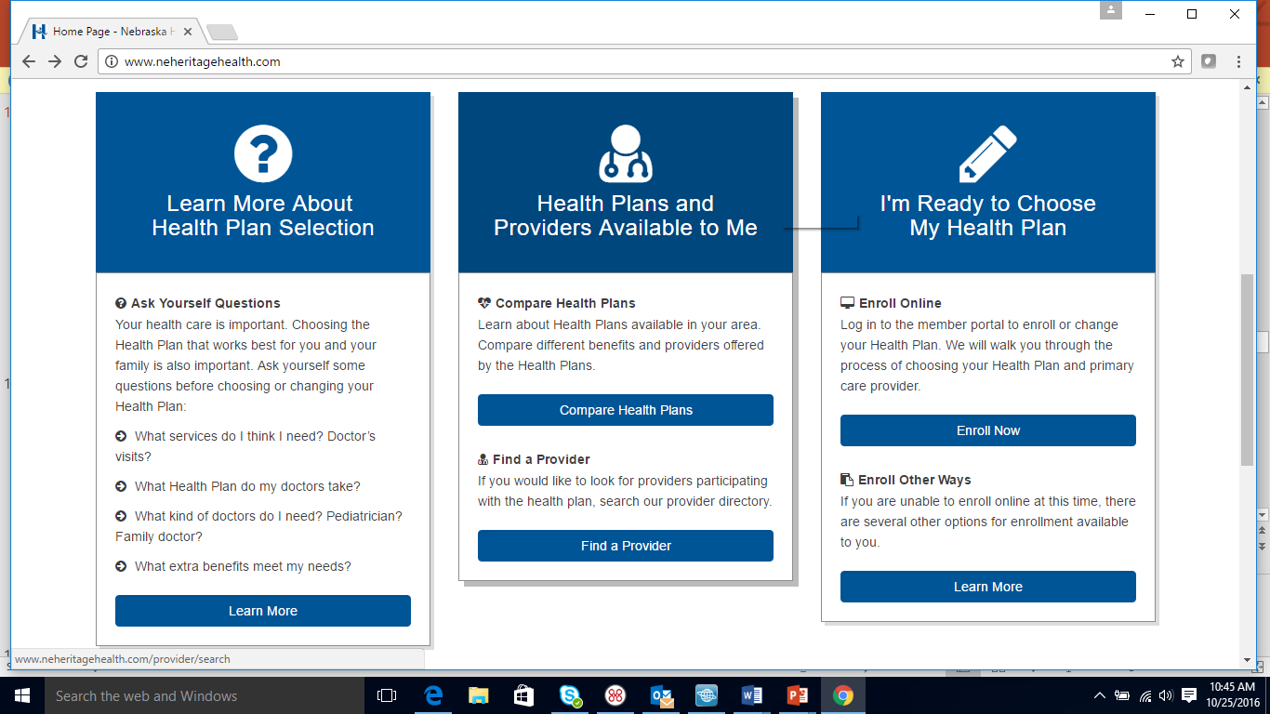
www.neheritagehealth.com

Slide 12
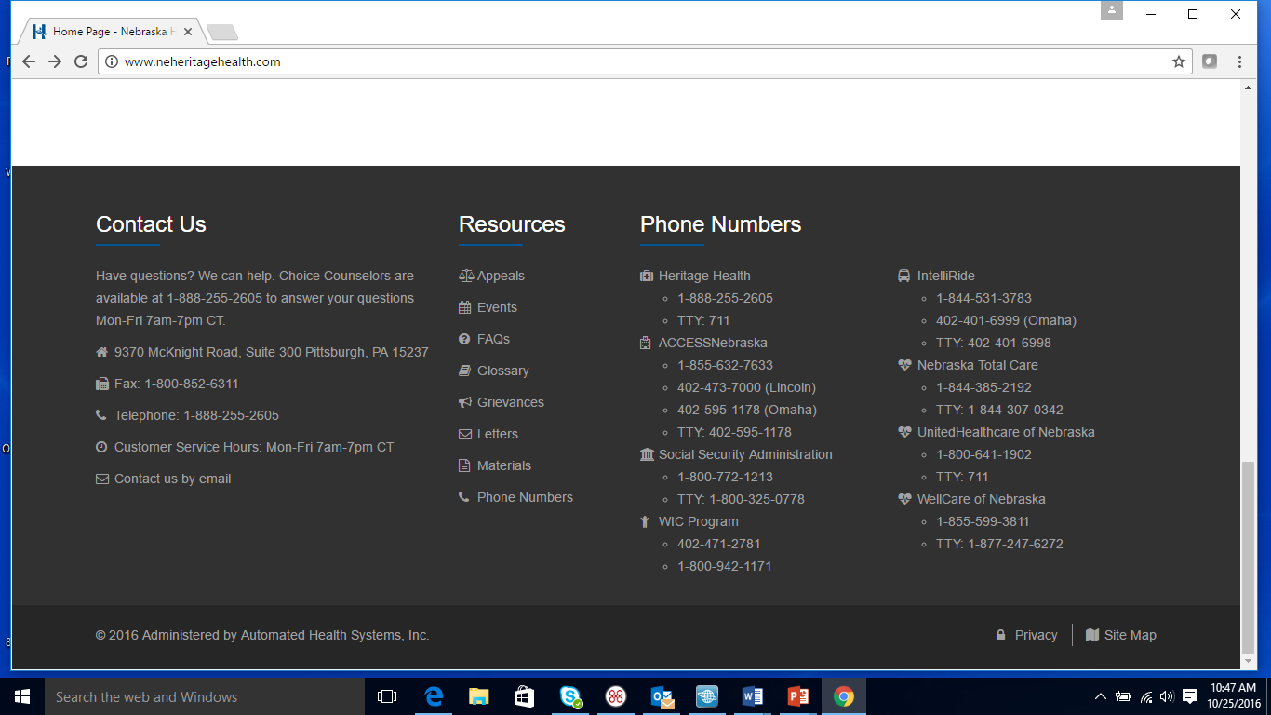
www.neheritagehealth.com

Slide 13

Español Website

Slide 14
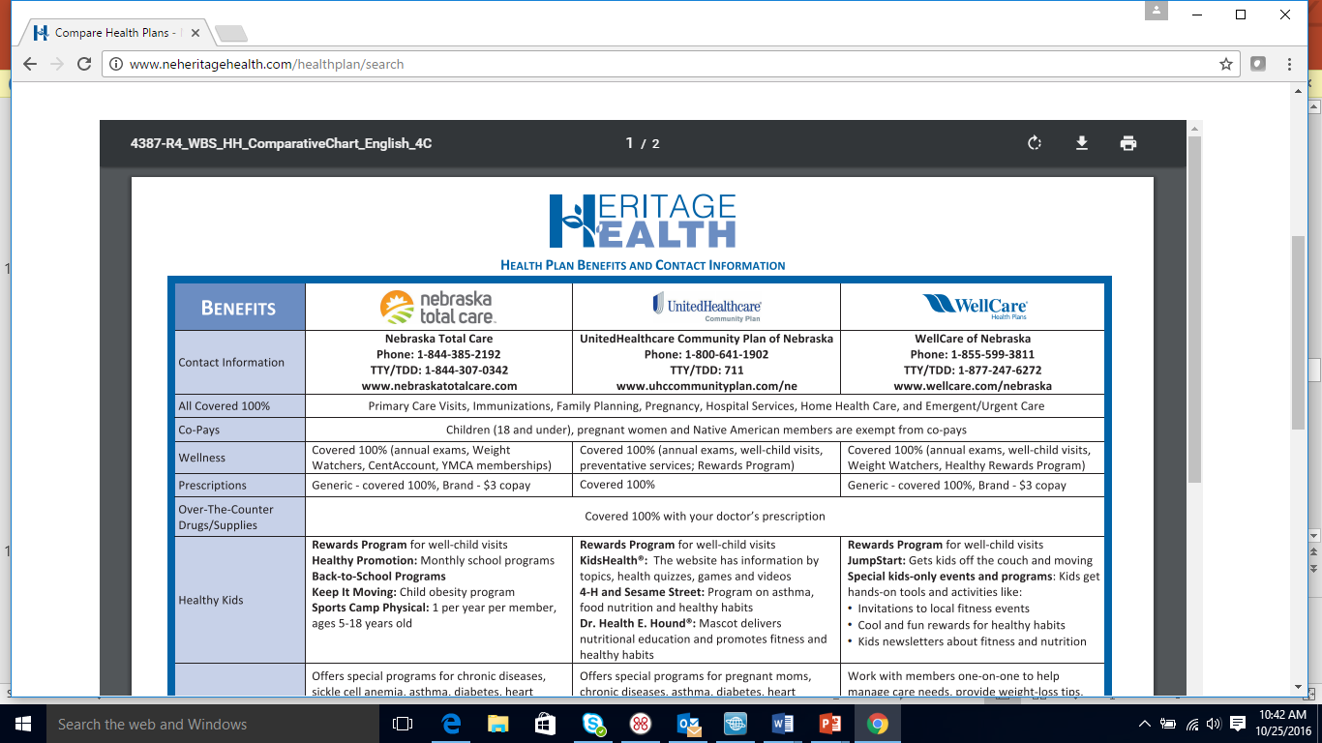
Compare Health plans Tab

Slide 15
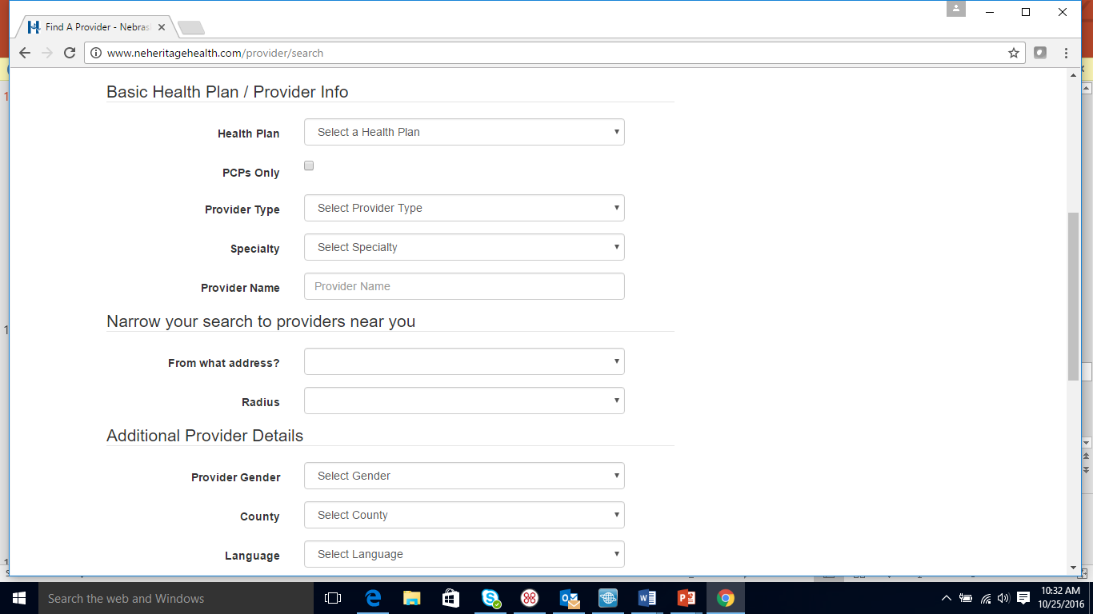
Find a Provider TAB

Slide 16

Resources Tab

Slide 17
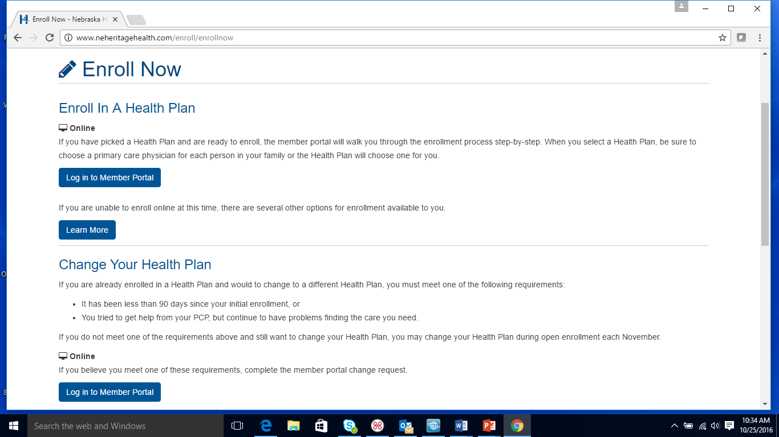
Enroll Now Tab

Slide 18


Log in to Member Portal
Register
Log in at www.neheritagehealth.com
Select
Select
Register as a new user

Slide 19
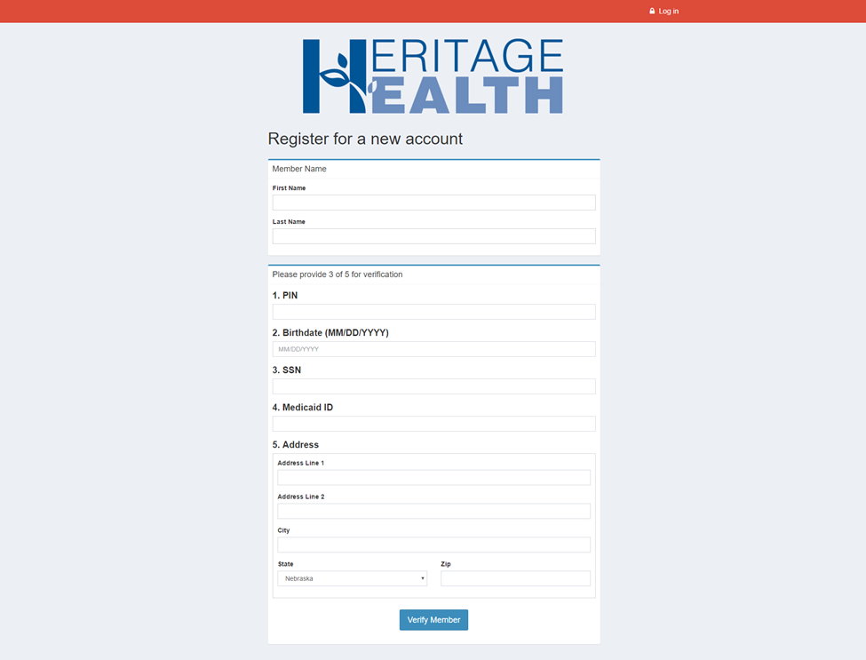
verification
Provide identity verification data

Slide 20
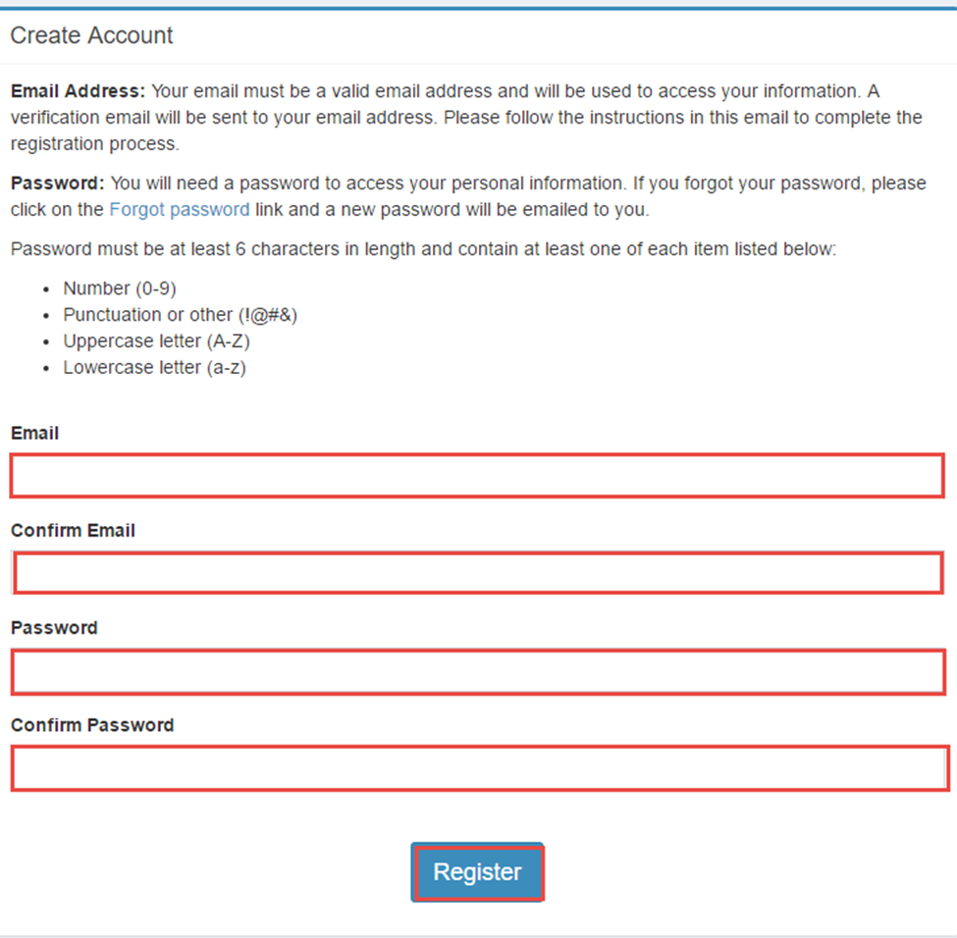
Create an Account
Only if you are the head of household or verified as 19 years or older

Slide 21
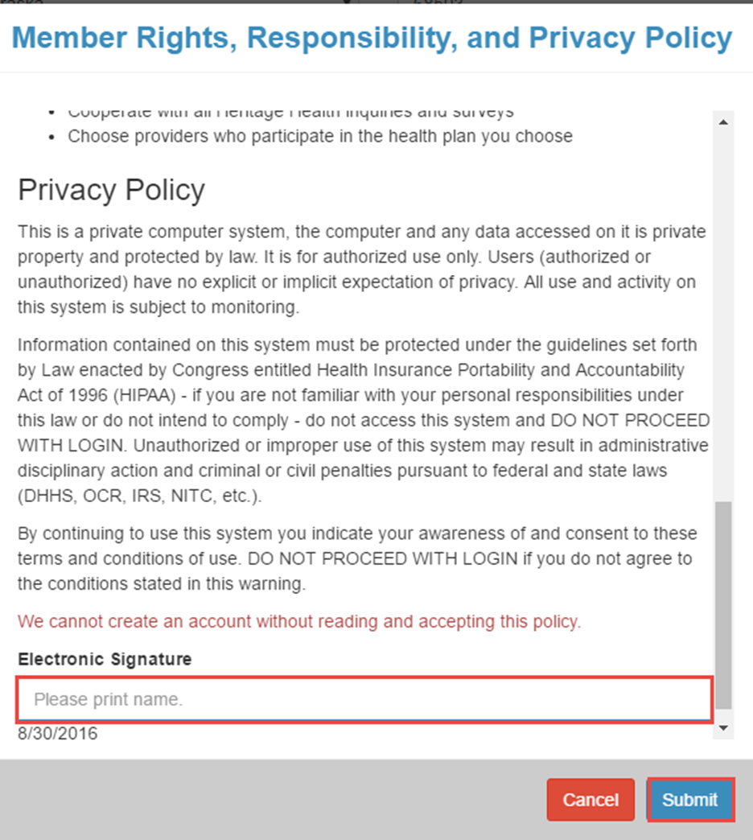
Requirements
Read the Member Rights, Responsibilities, and Privacy Policy
Electronic signature is required

Slide 22
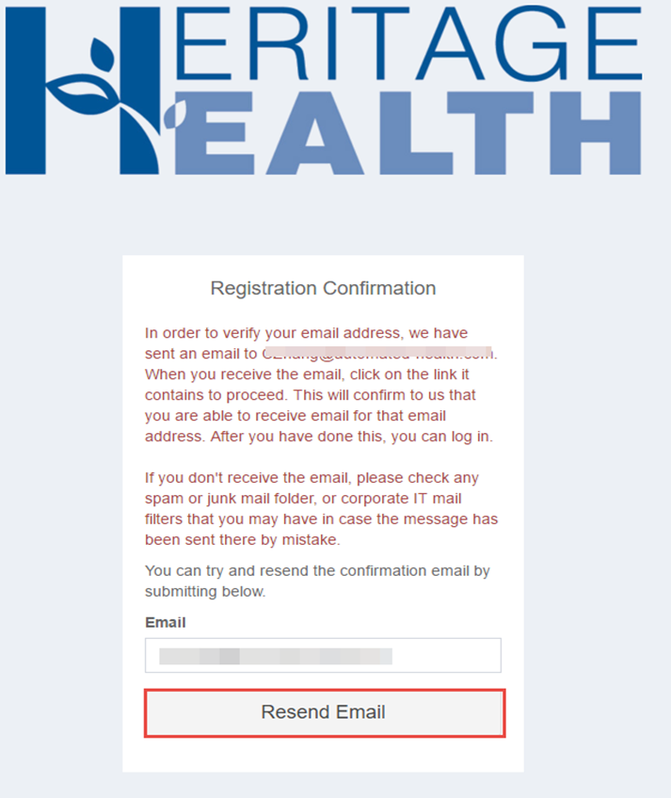
Registration Confirmation

Slide 23
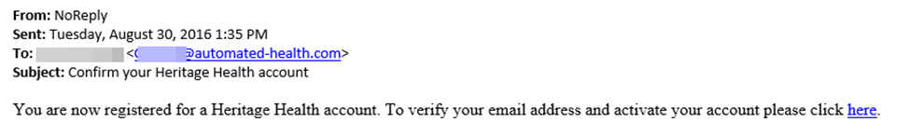
Registration E-mail

Slide 24
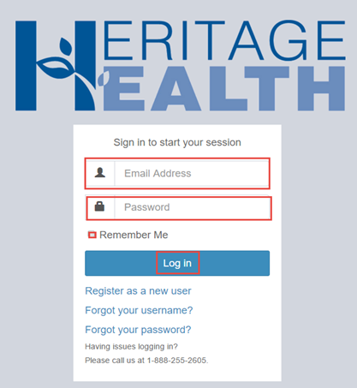
log in
Once registration is confirmed, member is able to log in to the member portal

Slide 25
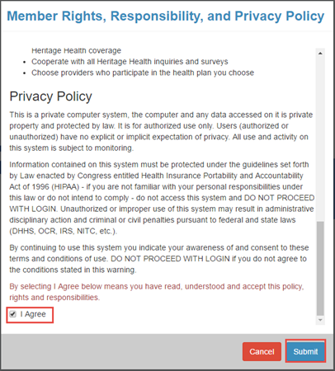
Accept the Policy
Every time a member logs in to access their record they must accept the Member Rights, Responsibilities and Privacy Policy

Slide 26
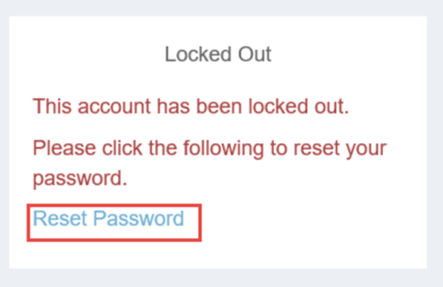
Failed Log In
After 3 failed attempts to log in, the account will be locked
The password will need to be reset

Slide 27
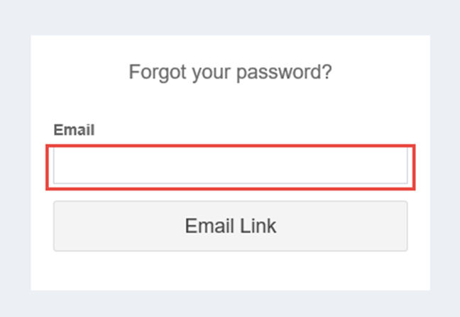
Reset Password
Start from the login page
Click Forgot password or Reset password

Slide 28
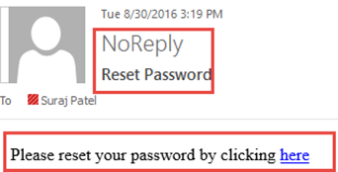
Email Reset
An e-mail will be generated to reset password

Slide 29
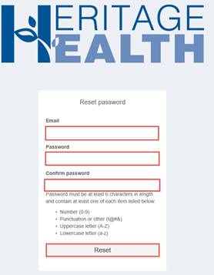
Fill Out Information
Complete the required information
Click “Reset”

Slide 30
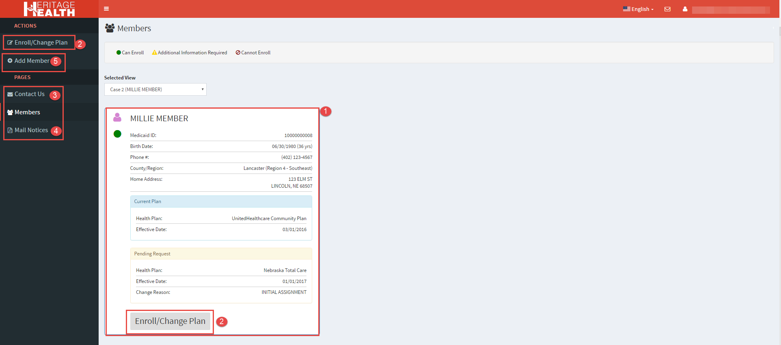
Case/Enrollment Status View
Notes:
Waiting de-identified screen shot

Slide 31
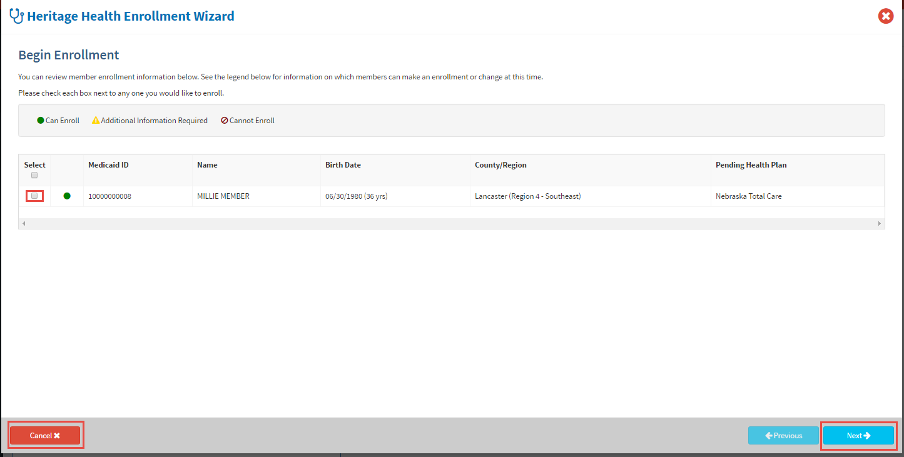
Enrollment Wizard
Notes:
Waiting de-identified screen shot

Slide 32
Plan Selection Tools
The member selects the health plan(s) he/she wishes to submit enrollment/change requests for
Online choice counseling tools:
  Search for all PCPs, specialists, and hospitals in the HHEB provider network
  Search for and select specific providers and hospitals
  Choices are logged and displayed along with the health plans in which they are available
  Compare plans by clicking on “See Comparison Chart.”

Slide 33
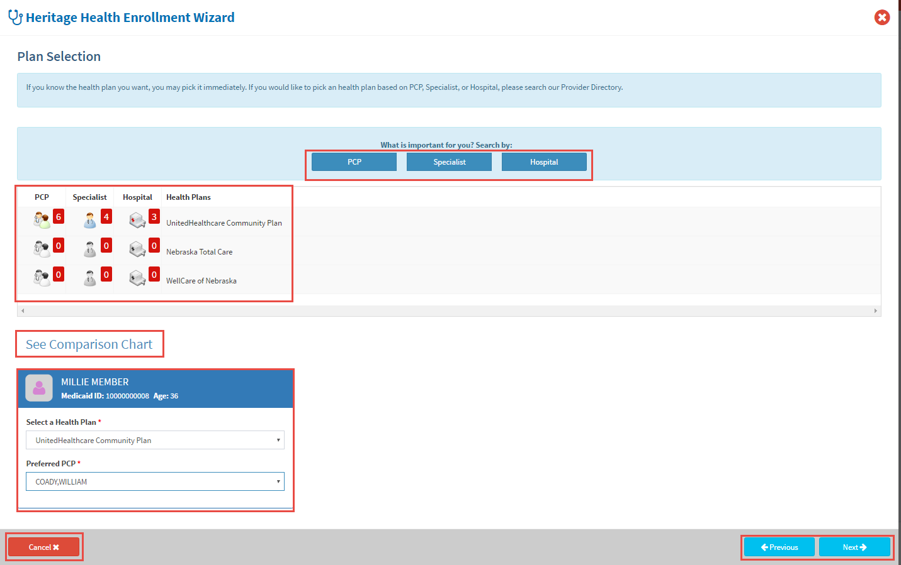
Plan Selection Screen
Once a choice has been made, the client selects the desired health plan and PCP (not required) and click “Next” to move ahead
Notes:
Waiting de-identified screen shot

Slide 34
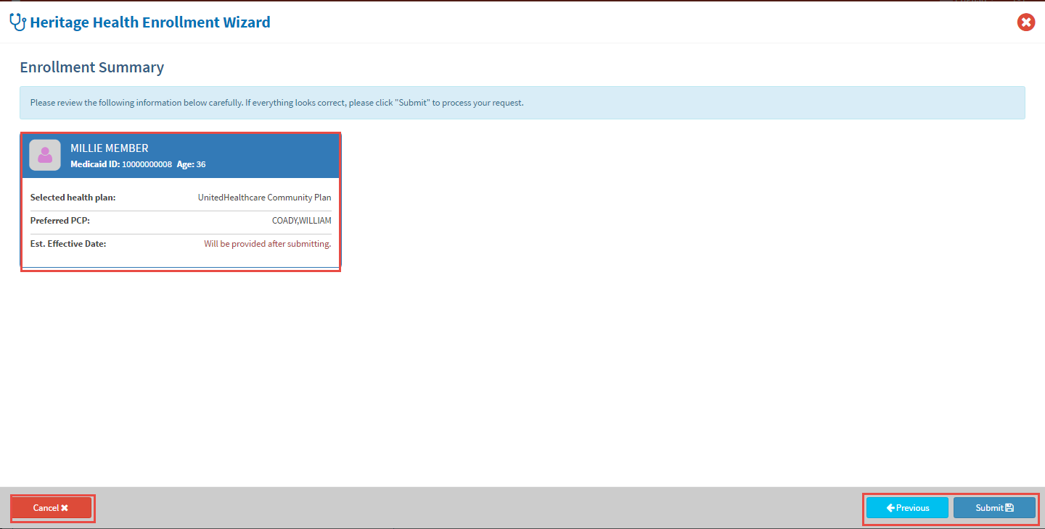
Enrollment Summary
Notes:
Waiting for de-identified screen shot

Slide 35
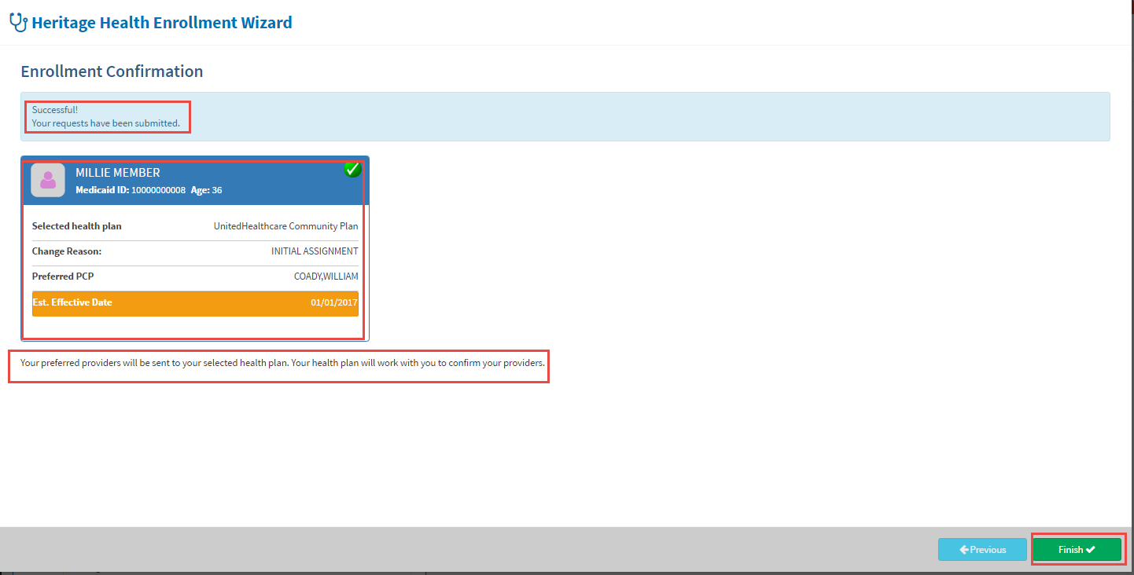
Enrollment Confirmation
Notes:
Waiting for de-identified screen shot

Slide 36
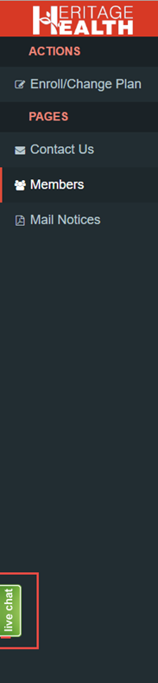
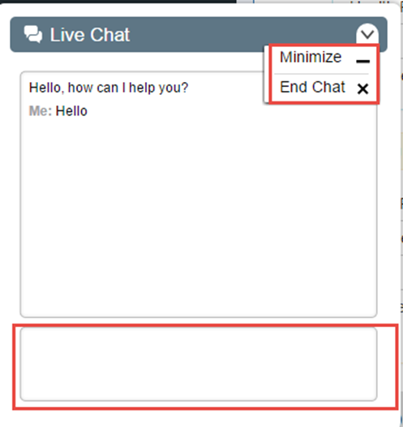
Live Chat
Live Chat can be initiated by clicking the live chat icon on the bottom left corner of the member page

Slide 37
Enroll: Phone
IVR (automatic enrollment)
1-888-255-2605 and select prompt #3
Information you will need
    date of birth (2digit month/day and 4digit year) then, press #
    last 4 of SS then, press #
    4digit PIN then, press #
  Select 1, 2 or 3 for plan (they are listed in different order with each call)
  System will repeat back the name of the plan selected
      If correct, press 1
      To make a different selection, press 2
Choice Counselor
1-888-255-2605 and select prompt #2
Verify identity
    Member name
    3 of 5 identifiers: address, PIN, DOB, SSN, Medicaid ID #
If member wants someone else to assist with process, member must give verbal permission for this one call
If member is unable to speak for themselves, must have the authorized representative form completed (guardian, POA, etc.)
Once verified, call center choice counselors will assist with making selection of plan

Slide 38
Enroll by Mail & Fax
Mail
Complete Plan selection form (head of household or member 19 or older for self)
Mail form to Heritage Health 9370 McKnight Road Suite #300 Pittsburgh, PA 15237
Fax
Complete Plan selection form (head of household or member 19 or older for self)
Fax enrollment form to 1-800-852-6311

Slide 39

Please don’t hesitate to contact us
Heritage Health Call Center
1-888-255-2605
TTY/TTD: 711
www.neheritagehealth.com

